Slide 1
Planning to improve the health of Santa Cruz County using the Mobilizing for Action through Planning and Partnerships Model
Tamara Maciel Bannan, M.P.H.
QI On-TAP

Slide 2


Overview
Describe the Mobilizing for Action through Planning and Partnerships (MAPP) tool
Provide an overview of the six phases of MAPP
Review proposed timeline and plan for MAPP process

Slide 3
Mobilizing for Action
through Planning and Partnerships

Slide 4

What is MAPP?
A community-wide strategic planning process for improving public health
Facilitated by public health leadership to help communities prioritize public health issues, identify resources for addressing them, and take action

Slide 5
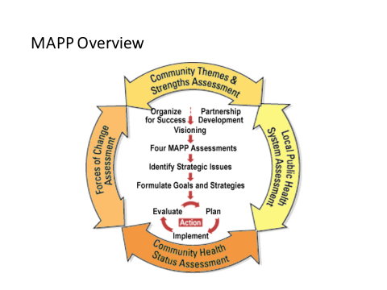
MAPP consists of 6 phases

Slide 6
Different from an Organization’s Strategic Plan
Community drives the process
MAPP provides the framework for a community-driven assessment & plan
Community participation leads to collective thinking across multiple sectors
Results tend to be more effective and sustainable
MAPP process brings diverse interests together

Slide 7
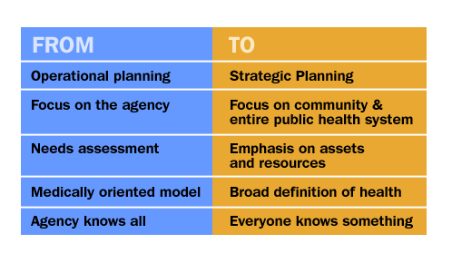
The MAPP Paradigm Shift

Slide 8
MAPP Phases
Organize for Success
Visioning
Four MAPP Assess-ments
Strategic Issues
Goals & Strategies
Action Cycle
MAPP consists of six phases

Slide 9


Prerequisites (Green)
CHA
SP
CHIP
Performance Management & Quality Improvement
Domains
1, 2, 3, 4, 5, 6, 7, 8, 9, 10
Essential Service
1, 2, 3, 4, 5, 6, 7, 8, 9 10
Essential service system performance measured using the NPHPSP instrument can inform health department PHAB domain performance. MAPP and NPHPSP can be deliberately designed to meet standards in domains 1, 3, 4, 5, 7, and 10.

Slide 10
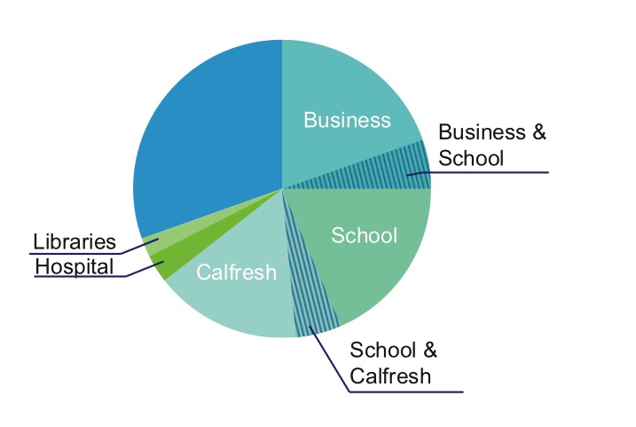
Collectively Many Sectors Can Make an Impact
The circle represents 100% of the community or county population

Slide 11
Timeline
Phase 1 – completed 9/16/2015
Phase 2 – Oct 2, 2015
Phase 3:
  CHSA - Dec 3, 2015
  CTSA – Jan/Feb 2016
  FCA – Dec 2, 2015
  LPHSA – Not doing this one
Phase 4 - Apr 2016
Phase 5 - May 2016
Phase 6 - Begins Jun 2016
  Steering Committee to determine frequency of meeting and reporting on progress

